Slide 1



Assignment-3
Web Programming
Student: Shukirillaev Mukhammad Sodik Sherzodbek Ugli
Department:Computer Engineering

Slide 2
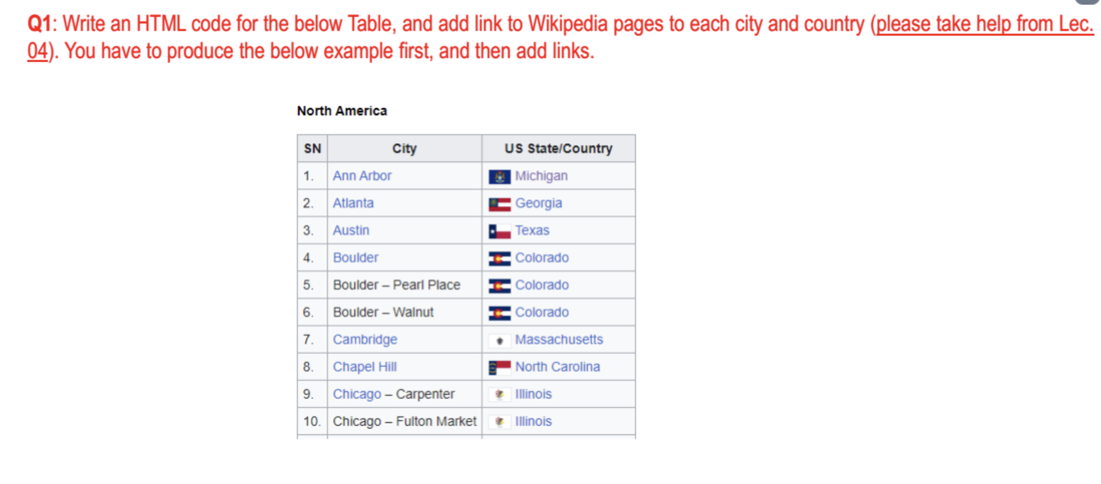
Question 1:

Slide 3
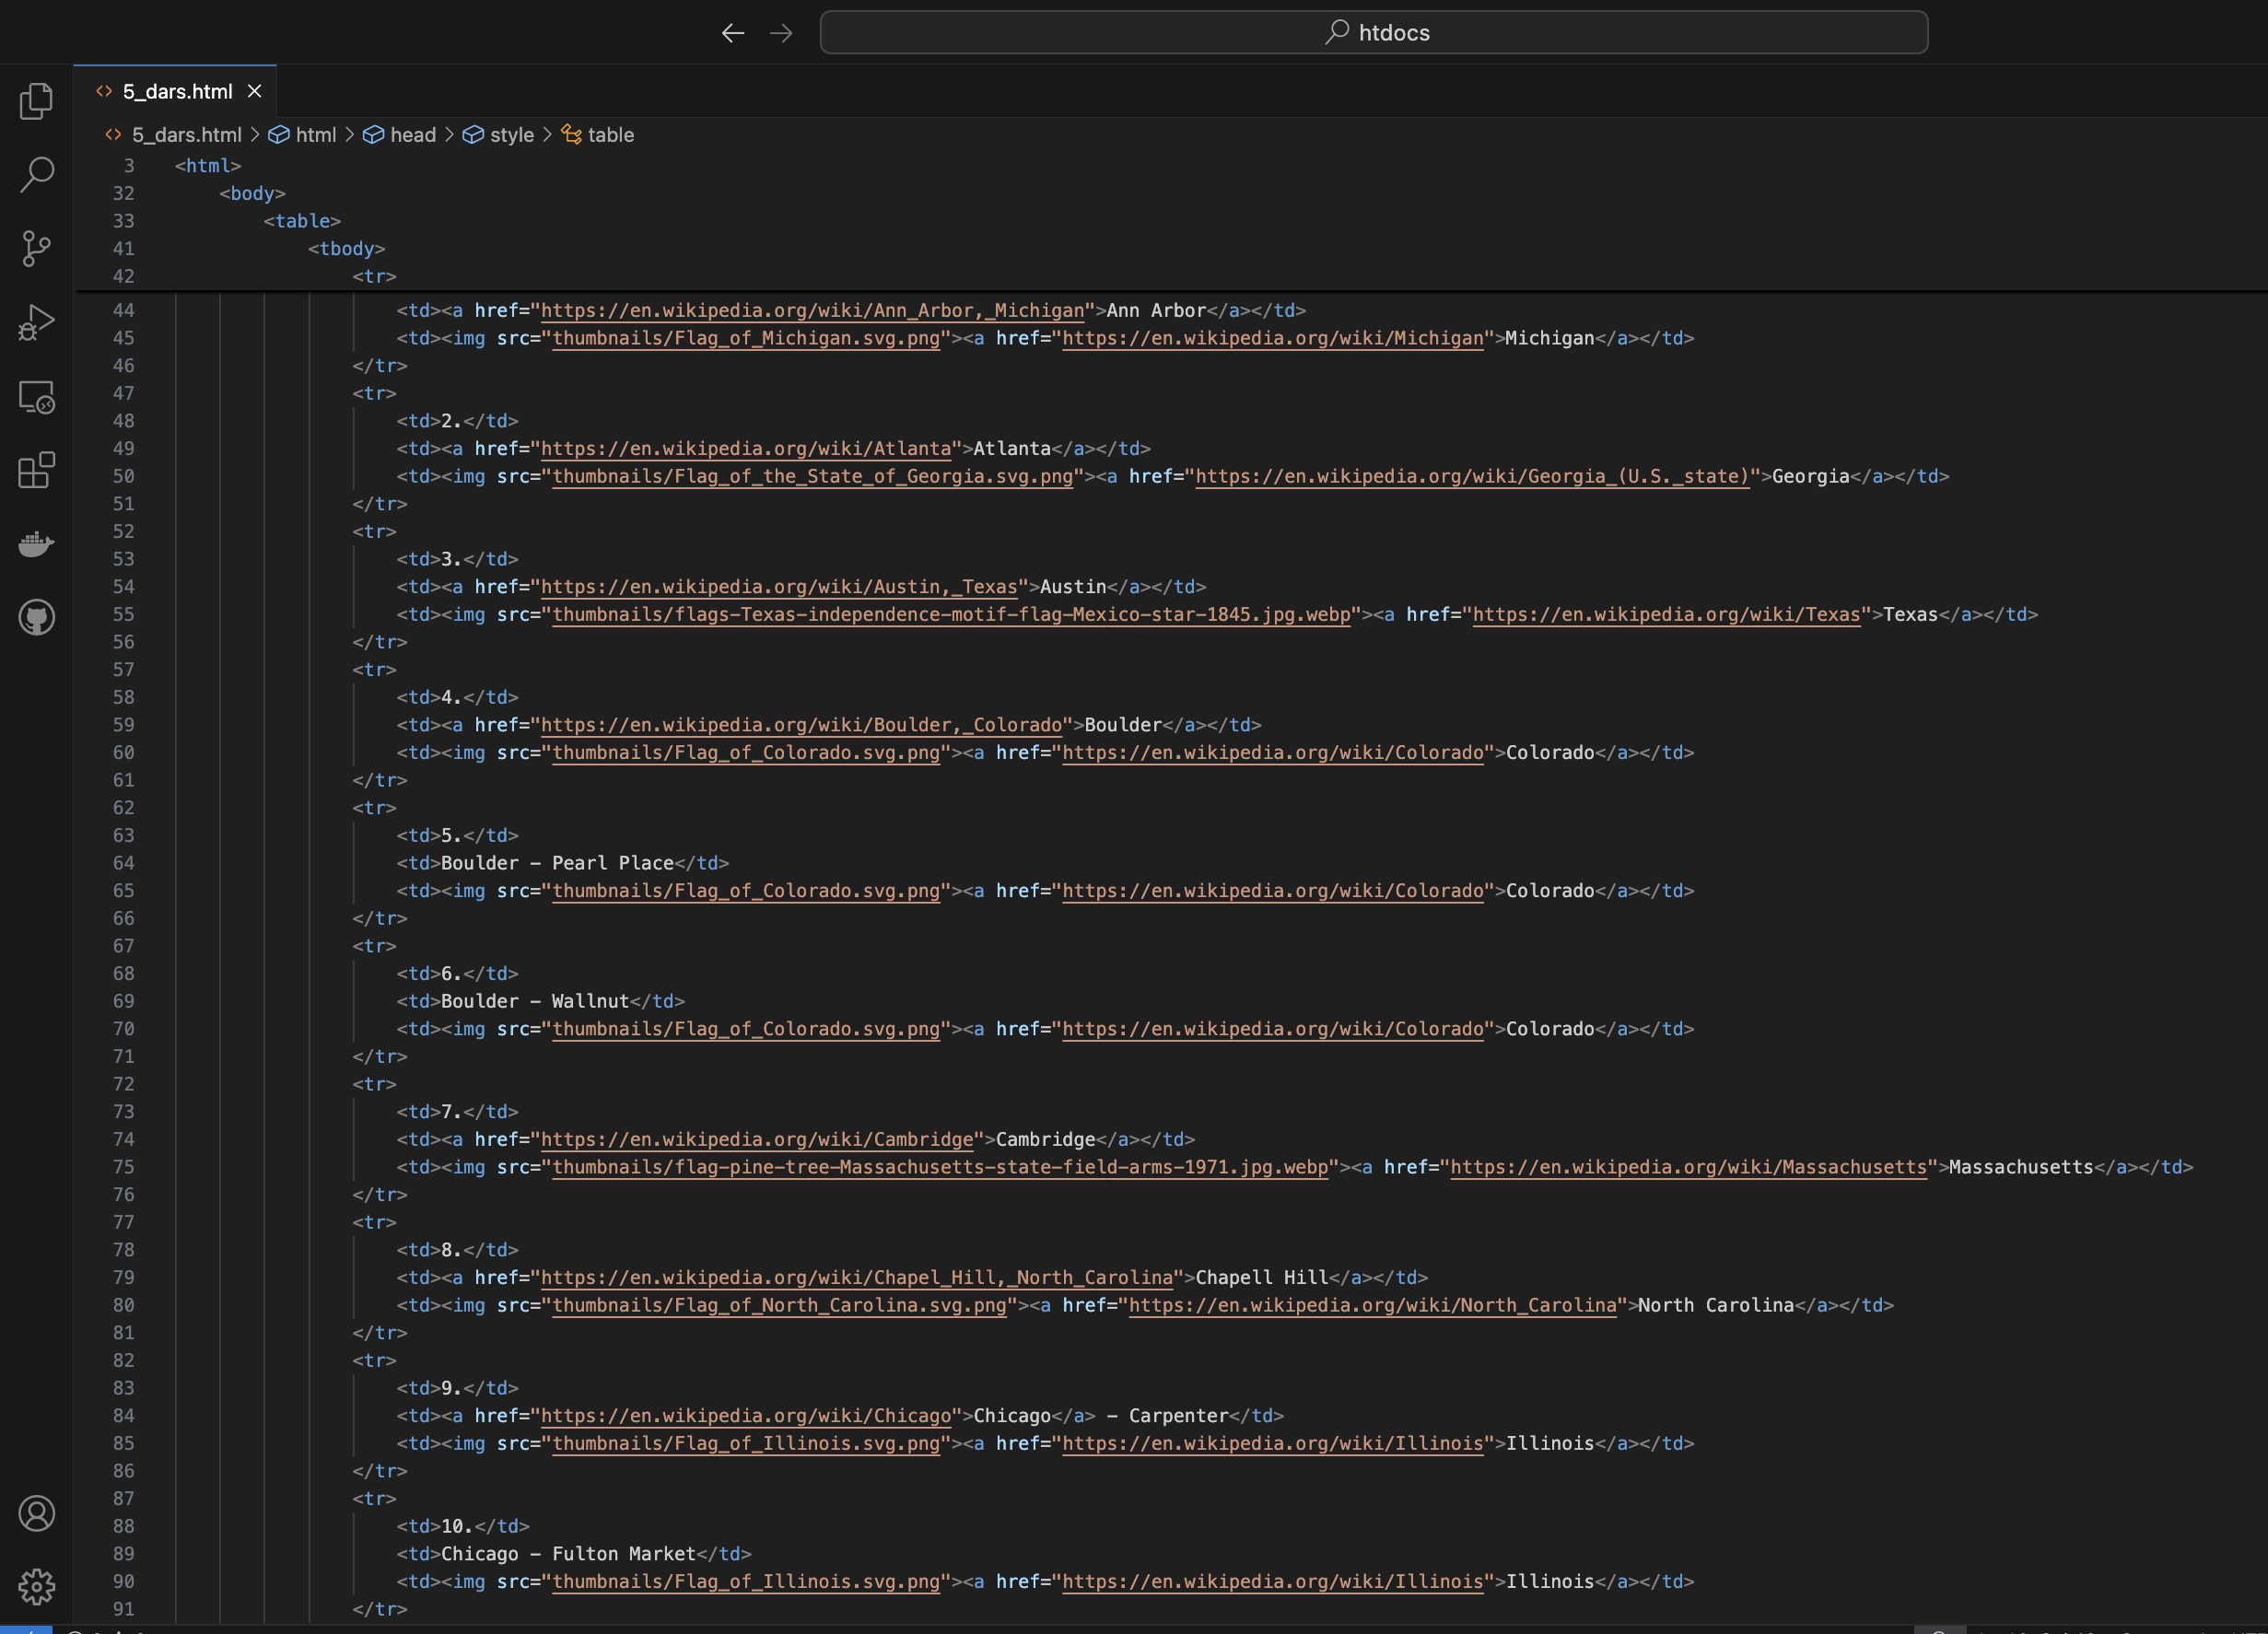
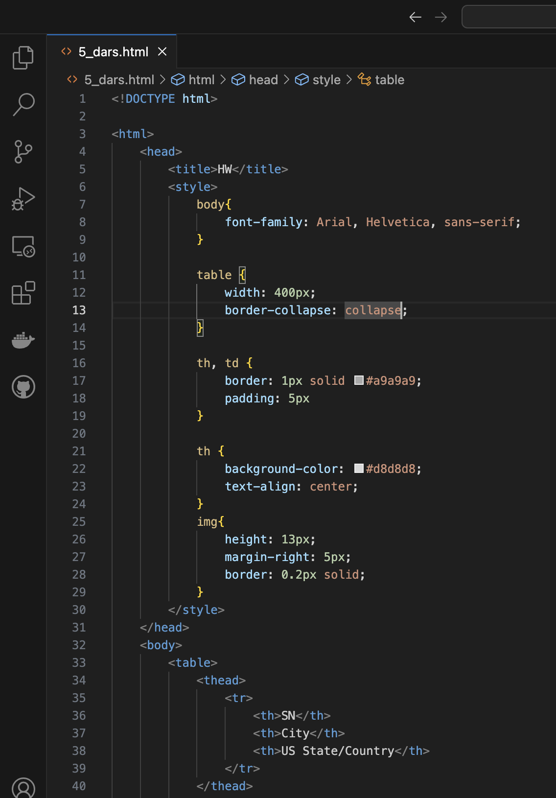
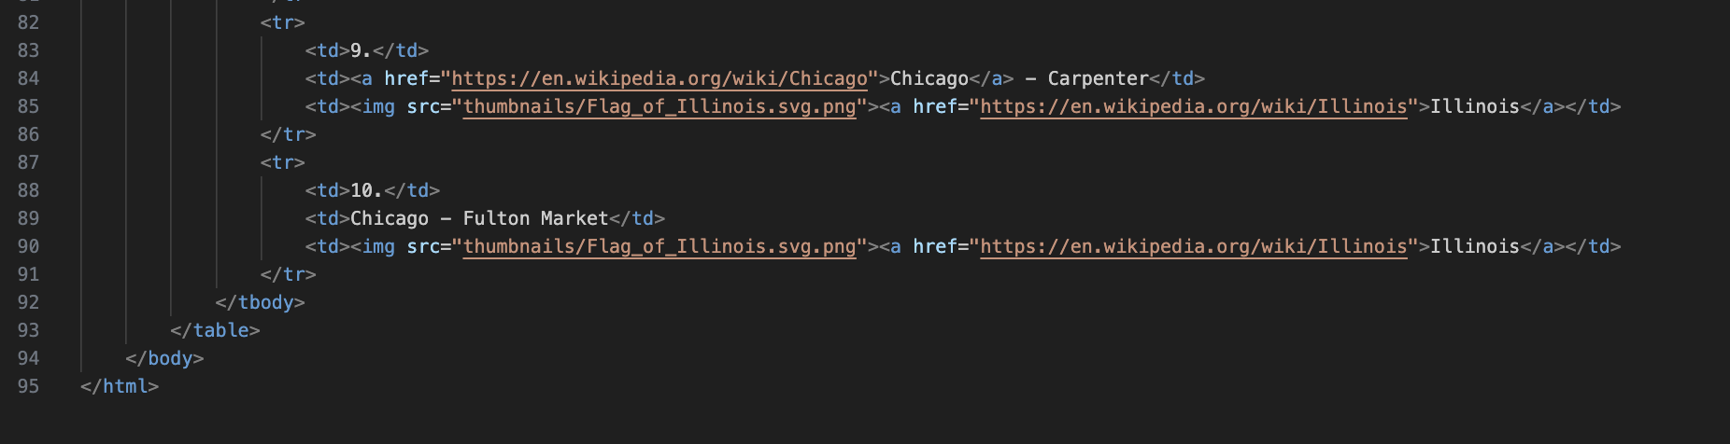
Code:

Slide 4
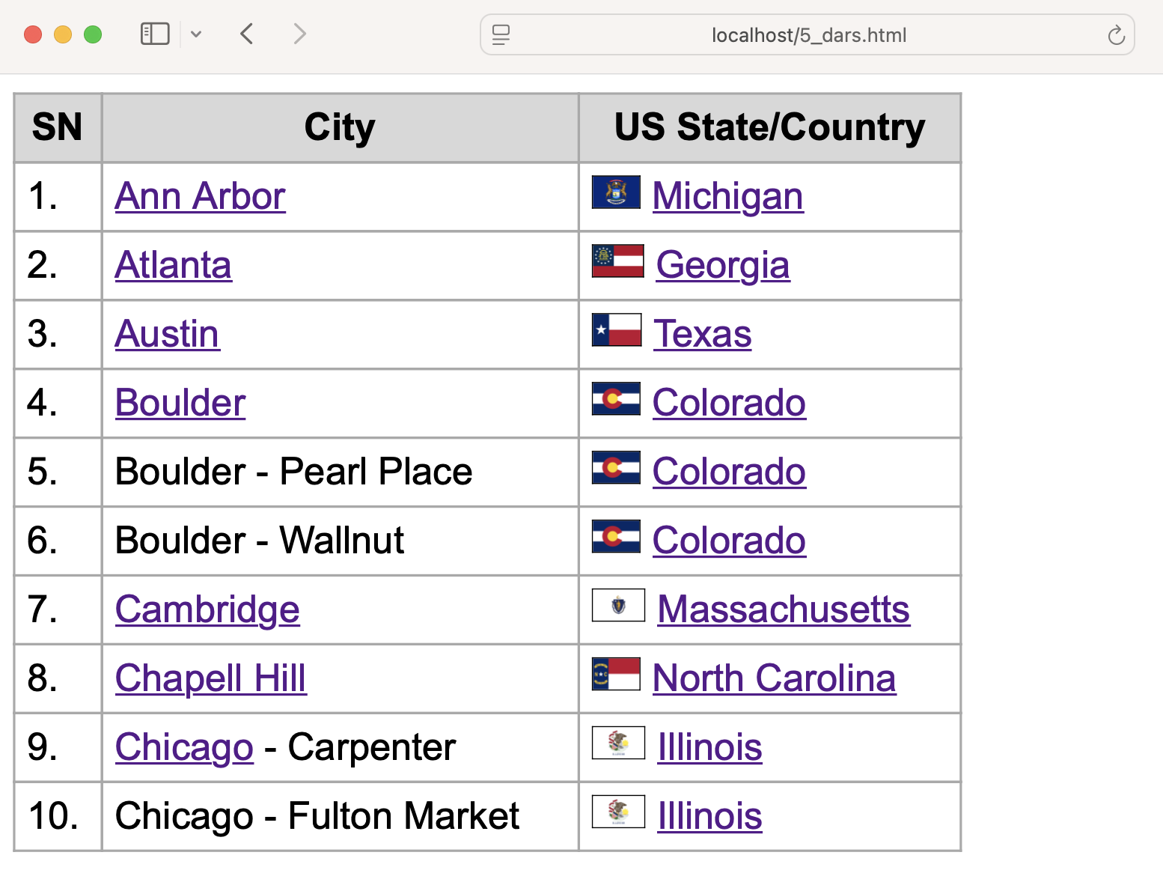
Result

Slide 5
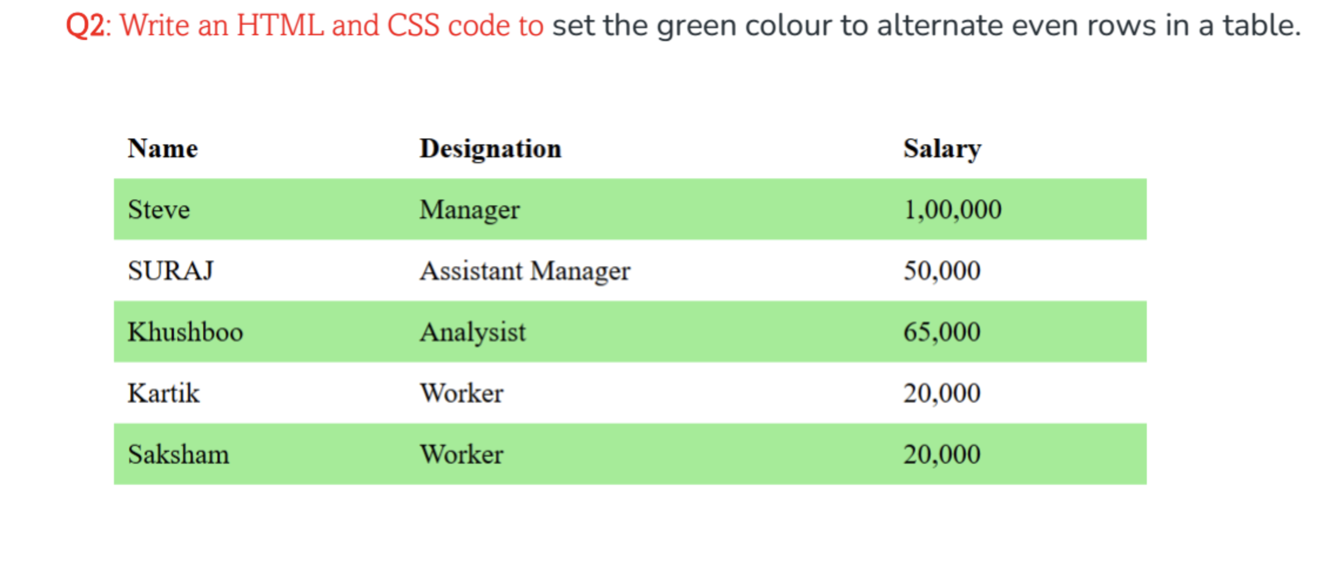
Question 2:

Slide 6
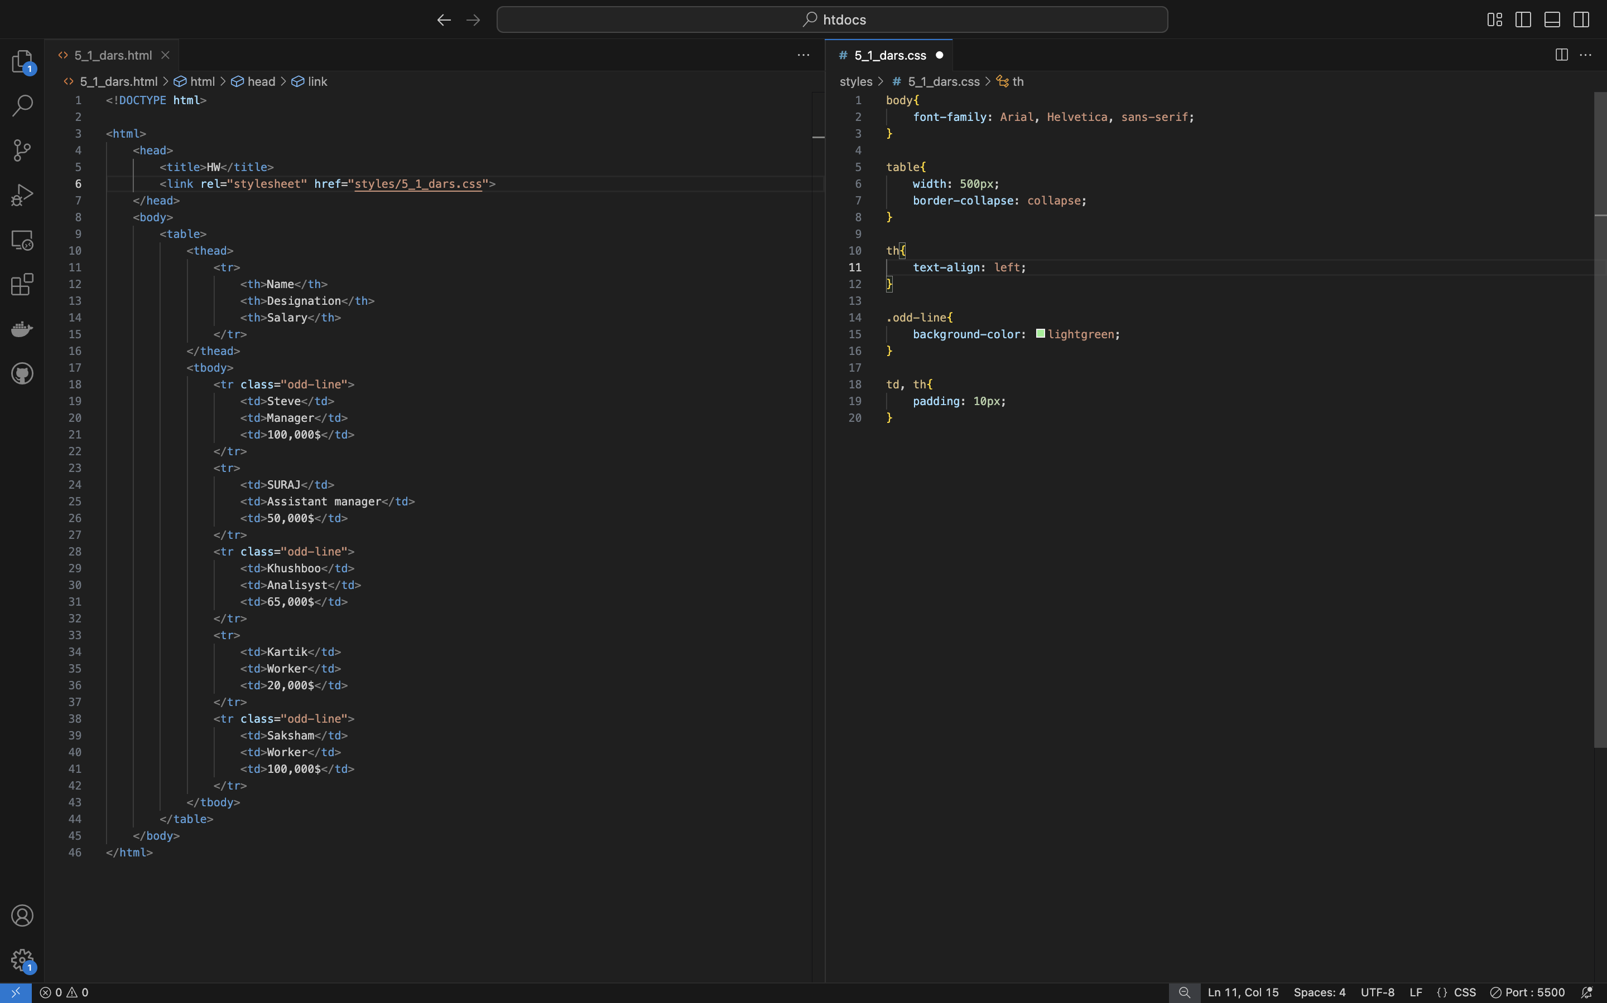
Code:

Slide 7
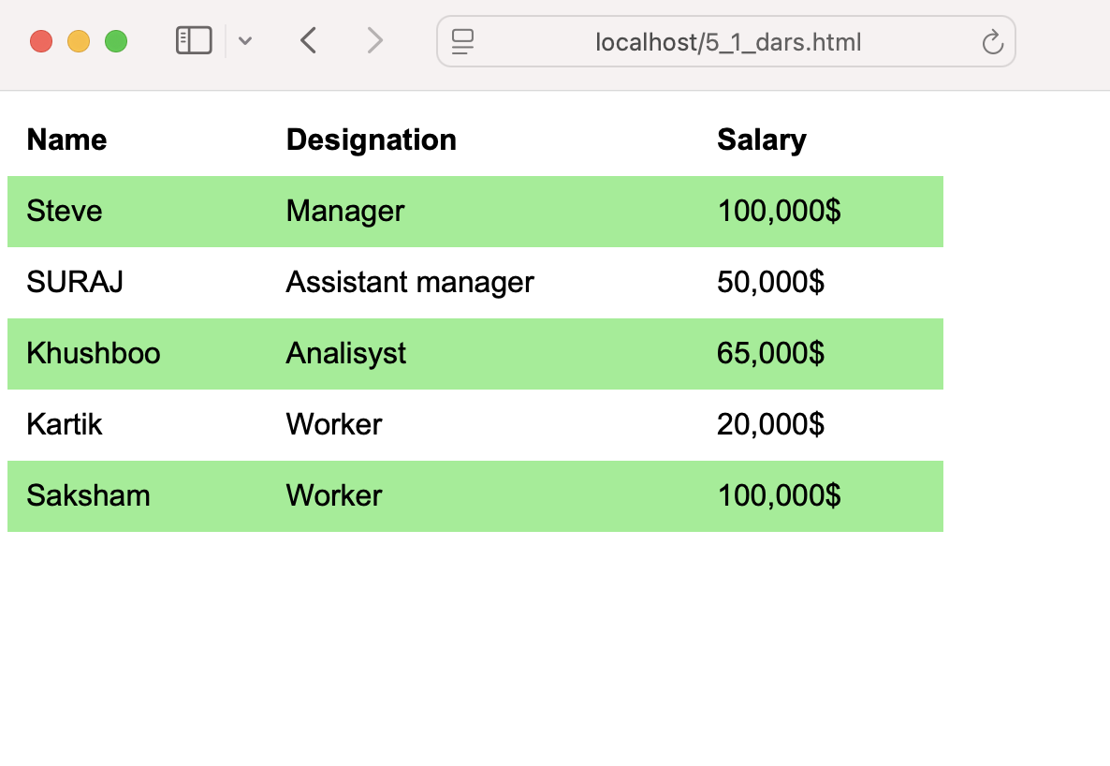
Result

Slide 8
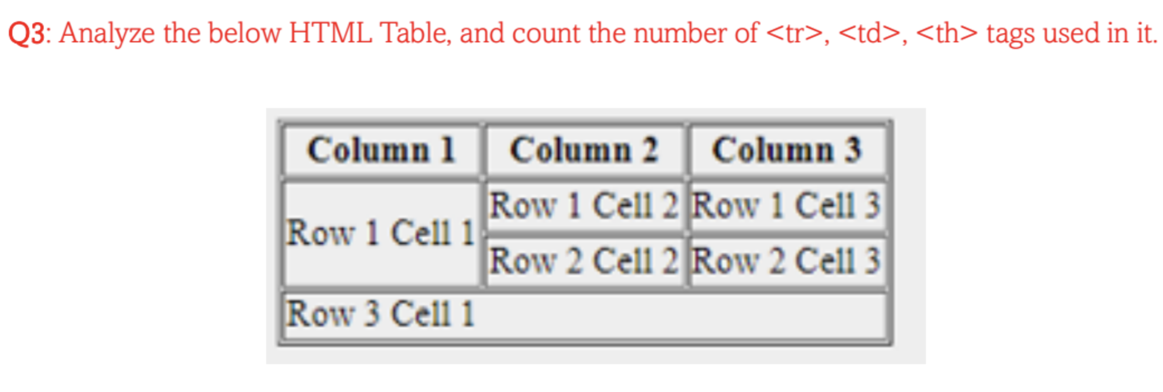
Question 3:

Slide 9
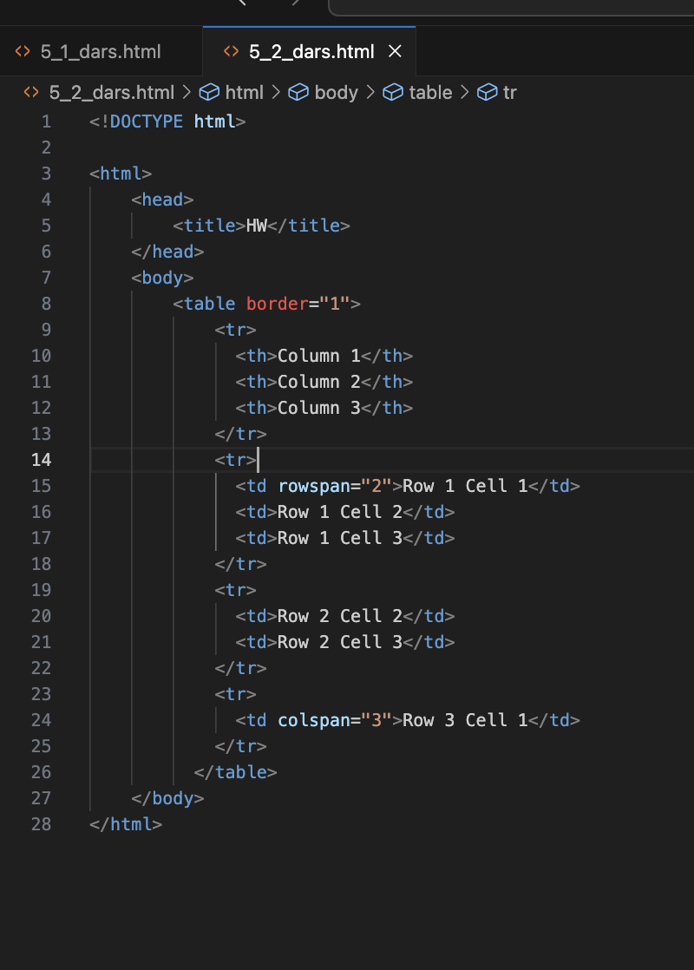
Code:

Slide 10
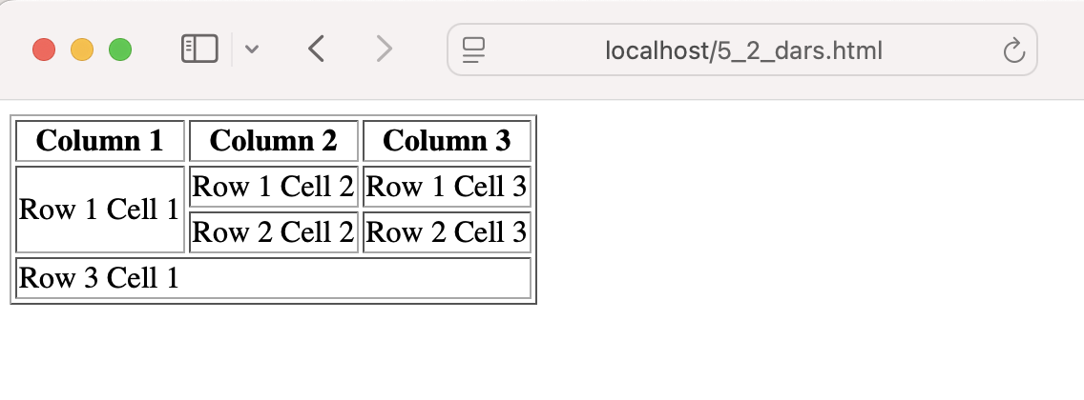
Result
d
<tr> tags: 4
<th> tags: 3
<td> tags: 6

Slide 11
Question 4:

Slide 12
Answer:
HTML tables are used to neatly organize and display data on a website. They’re really helpful for showing things like schedules, price lists, or any kind of information in rows and columns. This makes it easier for people to read and compare the data.

Slide 13
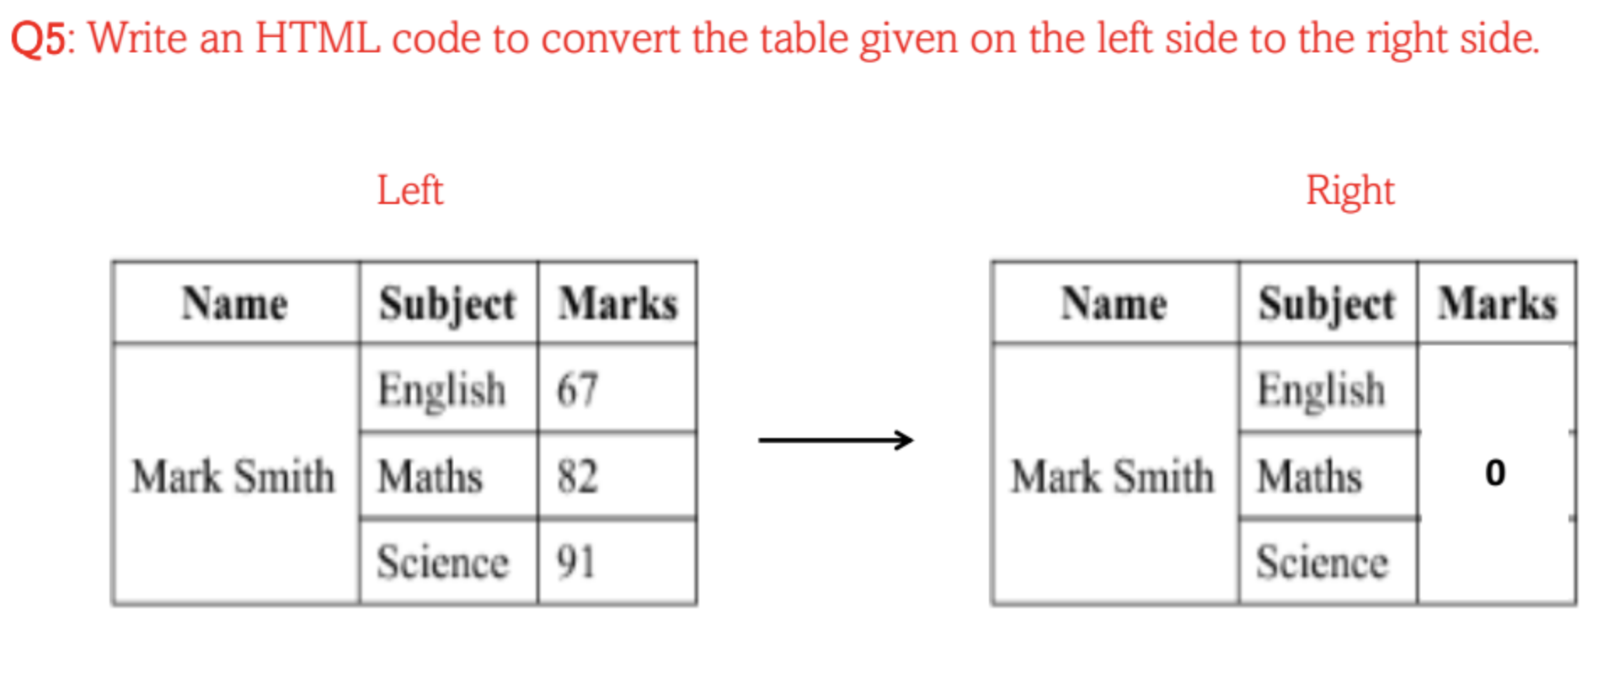
Question 5:

Slide 14
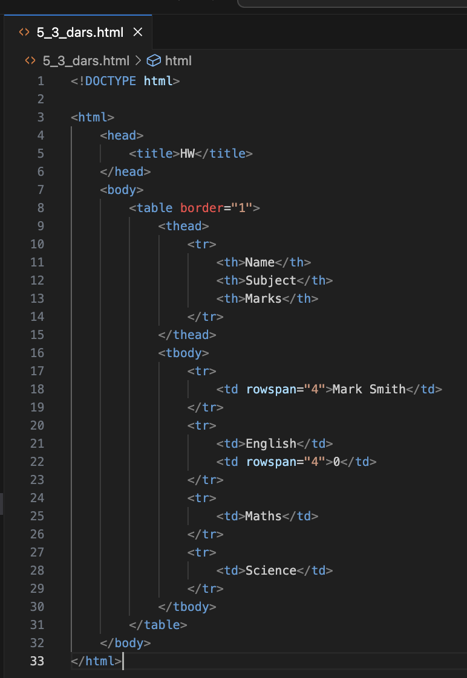
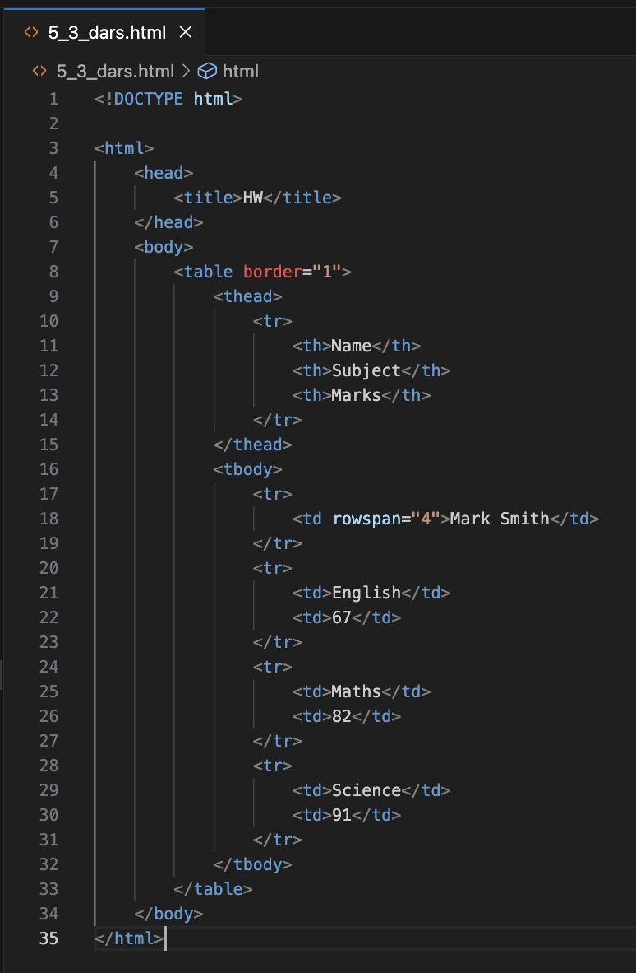
Code:

Slide 15
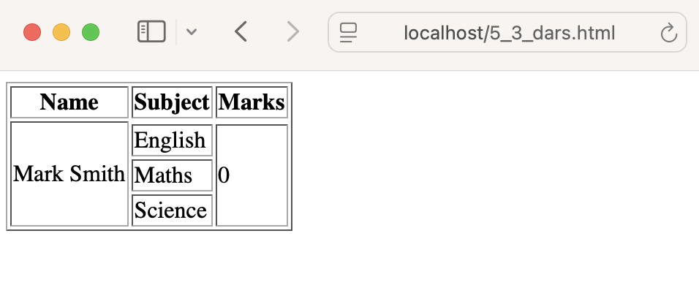
Result
d

Slide 16
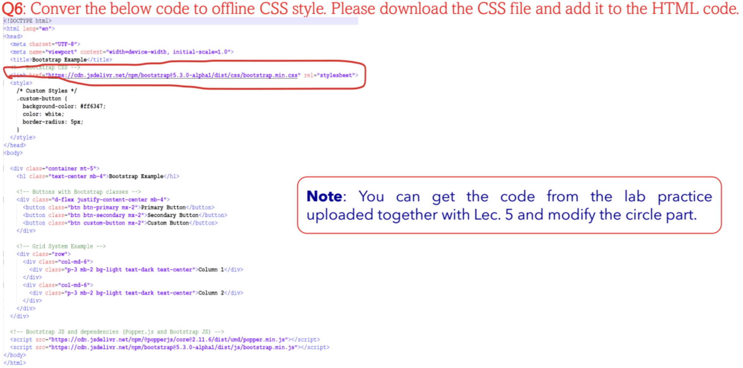
Question 6:

Slide 17
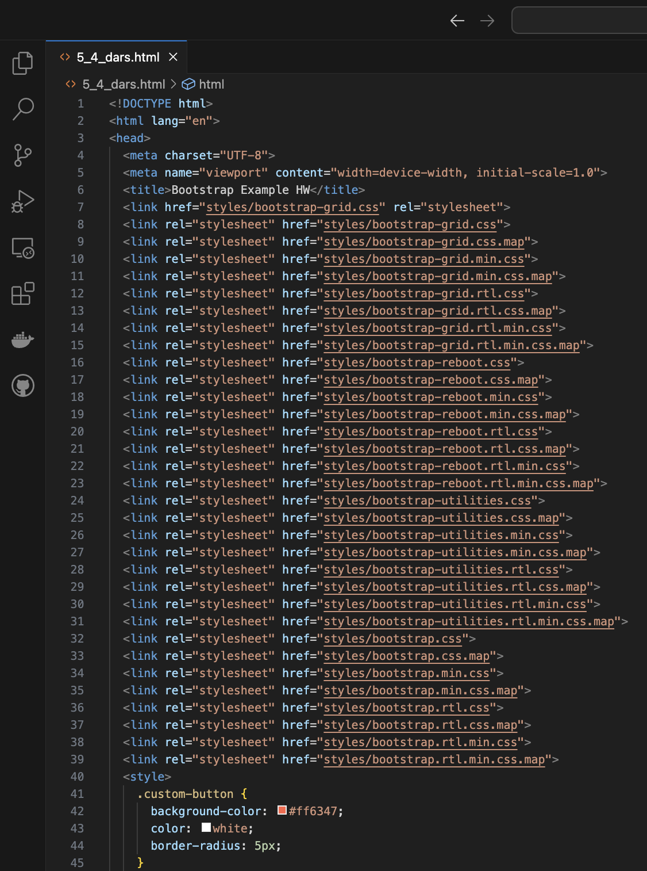
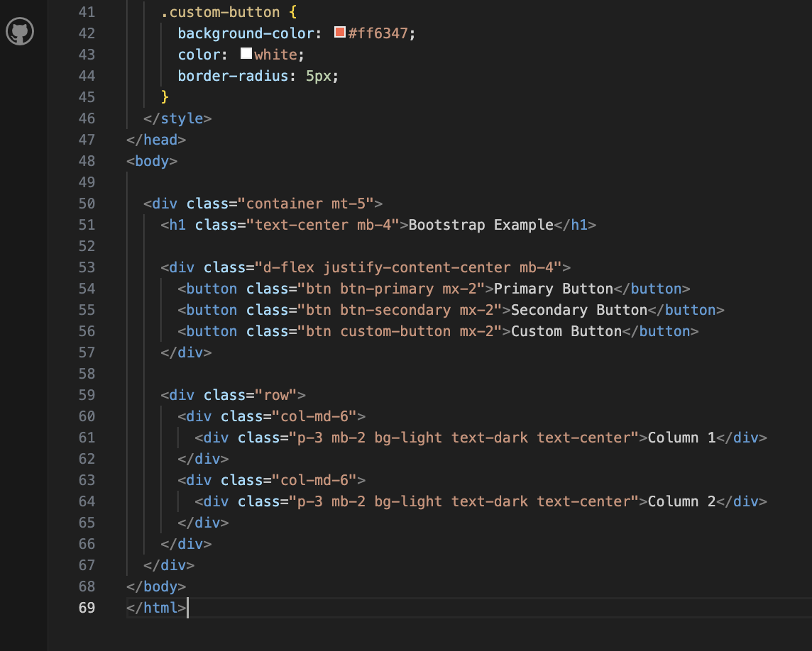
Code:

Slide 18
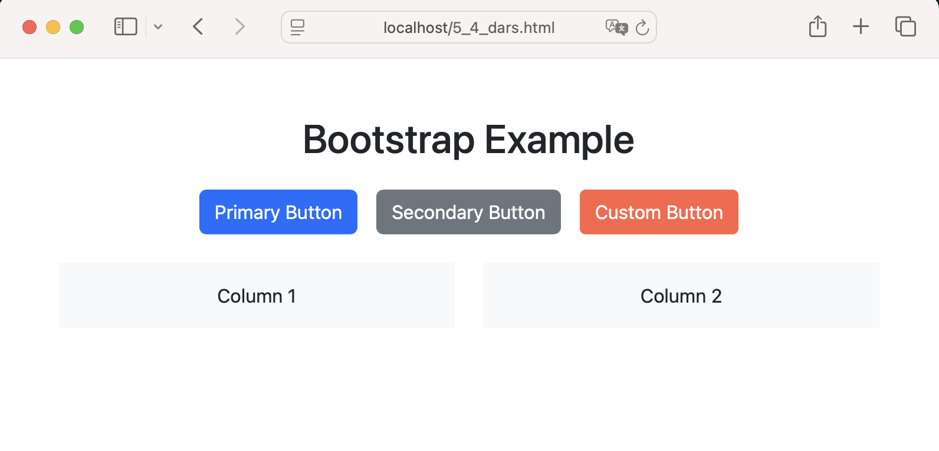
Result
d

